Slide 1
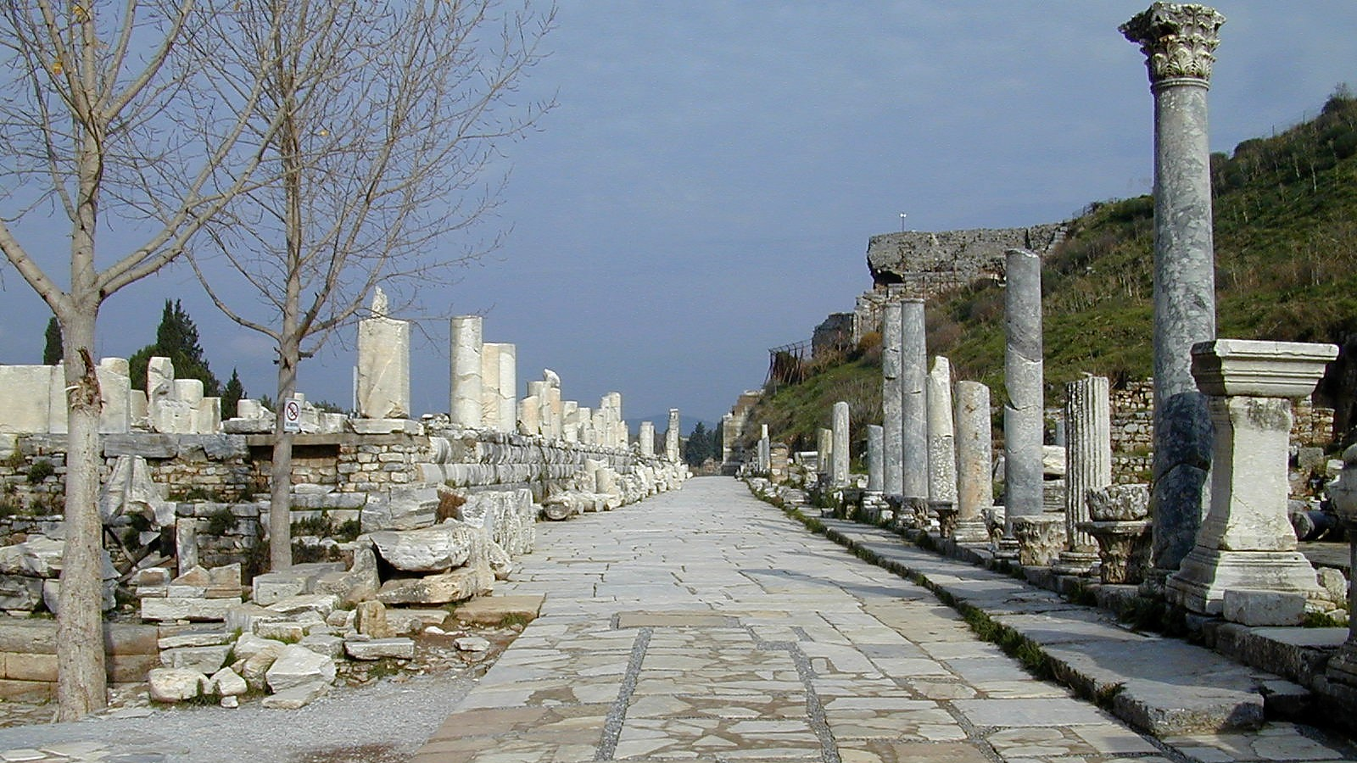
Ephesians 2.1-10
Ancient Street in Ephesus. Photo ©2006 Todd Bolen; BiblePlaces.com

Slide 2
Ephesians 2.1-2a ESV: And you were dead in the trespasses and sins in which you once walked…

Slide 3
Ephesians 2.1-2 ESV: And you were dead in the trespasses and sins in which you once walked, following the course of this world, following the prince of the power of the air, the spirit that is now at work in the sons of disobedience…

Slide 4
Ephesians 2.1-2 ESV: And you were dead in the trespasses and sins in which you once walked, following the course of this world, following the prince of the power of the air, the spirit that is now at work in the sons of disobedience…

Slide 5
Ephesians 2.1-3 ESV : And you were dead in the trespasses and sins in which you once walked, following the course of this world, following the prince of the power of the air, the spirit that is now at work in the sons of disobedience-- among whom we all once lived in the passions of our flesh, carrying out the desires of the body and the mind, and were by nature children of wrath, like the rest of mankind.

Slide 6
Ephesians 2.1-3 ESV: And you were dead in the trespasses and sins in which you once walked, following the course of this world, following the prince of the power of the air, the spirit that is now at work in the sons of disobedience-- among whom we all once lived in the passions of our flesh, carrying out the desires of the body and the mind, and were by nature children of wrath, like the rest of mankind.

Slide 7
Ephesians 2.4-5a ESV: But God, being rich in mercy, because of the great love with which he loved us, even when we were dead in our trespasses…

Slide 8
Ephesians 2.4-5 ESV: But God, being rich in mercy, because of the great love with which he loved us, even when we were dead in our trespasses, made us alive together with Christ-- by grace you have been saved…

Slide 9
Ephesians 2.4-5 ESV: But God, being rich in mercy, because of the great love with which he loved us, even when we were dead in our trespasses, made us alive together with Christ-- by grace you have been saved…

Slide 10
Ephesians 2.4-7 ESV: But God, being rich in mercy, because of the great love with which he loved us, even when we were dead in our trespasses, made us alive together with Christ-- by grace you have been saved-- and raised us up with him and seated us with him in the heavenly places in Christ Jesus, so that in the coming ages he might show the immeasurable riches of his grace in kindness toward us in Christ Jesus.

Slide 11
Ephesians 2.4-7 ESV: But God, being rich in mercy, because of the great love with which he loved us, even when we were dead in our trespasses, made us alive together with Christ-- by grace you have been saved-- and raised us up with him and seated us with him in the heavenly places in Christ Jesus, so that in the coming ages he might show the immeasurable riches of his grace in kindness toward us in Christ Jesus.

Slide 12
Ephesians 2.8-9 ESV: For by grace you have been saved through faith. And this is not your own doing; it is the gift of God, not a result of works, so that no one may boast.

Slide 13
Ephesians 2.10 ESV: For we are his workmanship, created in Christ Jesus for good works, which God prepared beforehand, that we should walk in them.

Slide 14
Implications:
Avoid feelings of self-righteousness.
Be assured of your salvation.
Focus on your relationship with God; live for him!

Slide 15
Ephesians 2.1-10
study materials
available at www.groben.com
Ancient Street in Ephesus. Photo ©2006 Todd Bolen; BiblePlaces.com

